Slide 1
Point Of Sale Inventory system

Slide 2
Point Of Sale Inventory system
Point of sale is a Laravel project that is known as POS. POS is a very easy tool to use. This project can be used in any type of retail store, where the purchase and sale process is carried out. The Point of Sale System is easy to use and can handle multiple invoices and look for the option of open invoice and look for the product from POS and can make a Purchase Order to the Supplier and a Coupon Card and can export the Report in PDF format and Gain and Loss and more. Easy to configure the application. Multiple points of sale can be used online, mobile devices, iPads, Android tablets or laptops. Responsive on any device.

Slide 3
Features
Completely 100% sensitive and dynamic
Good role management
Bulk loading of the product list in form
Warehouse and batch management system
Show all brands and list of suppliers
The administrator can set the VAT / global tax or in a single product
The system can generate coupons and export as pdf
Each product has a unique bar code sign

Slide 4
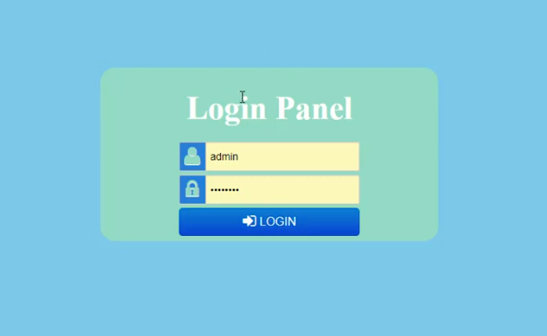

Slide 5
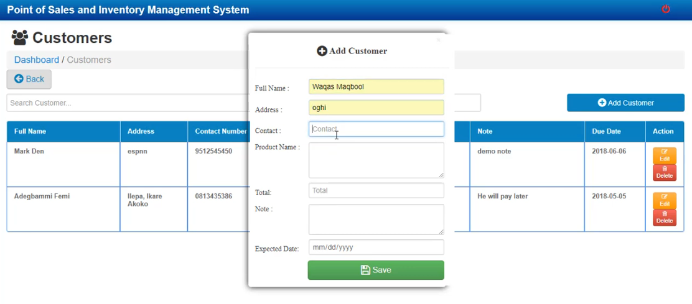

Slide 6
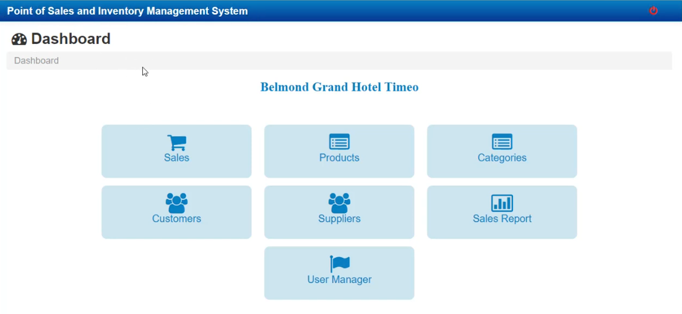

Slide 7
